Slide 1
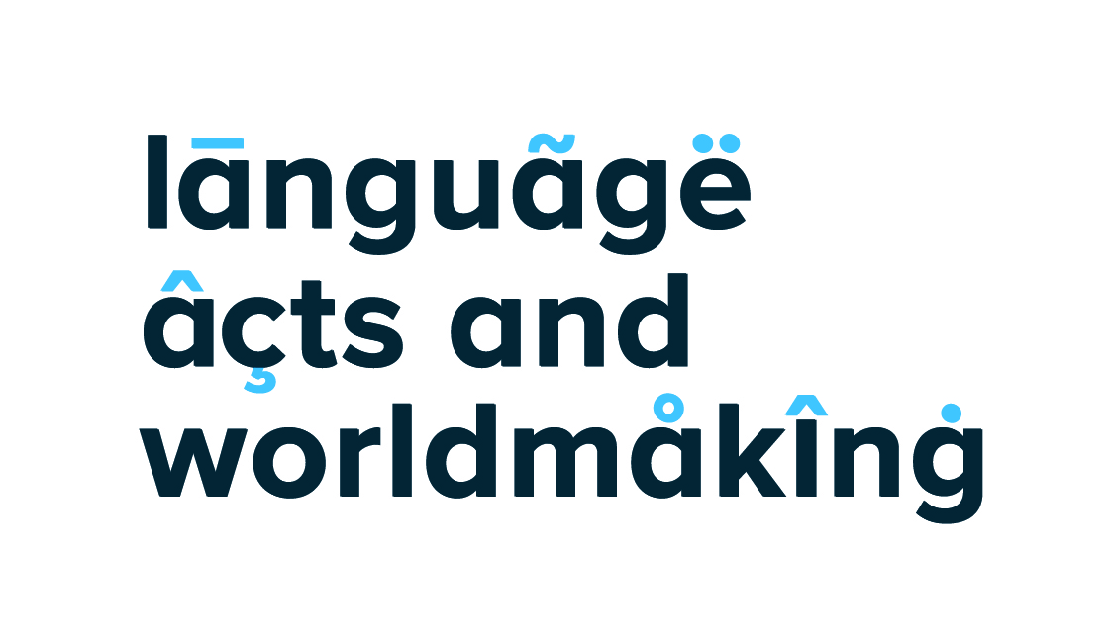
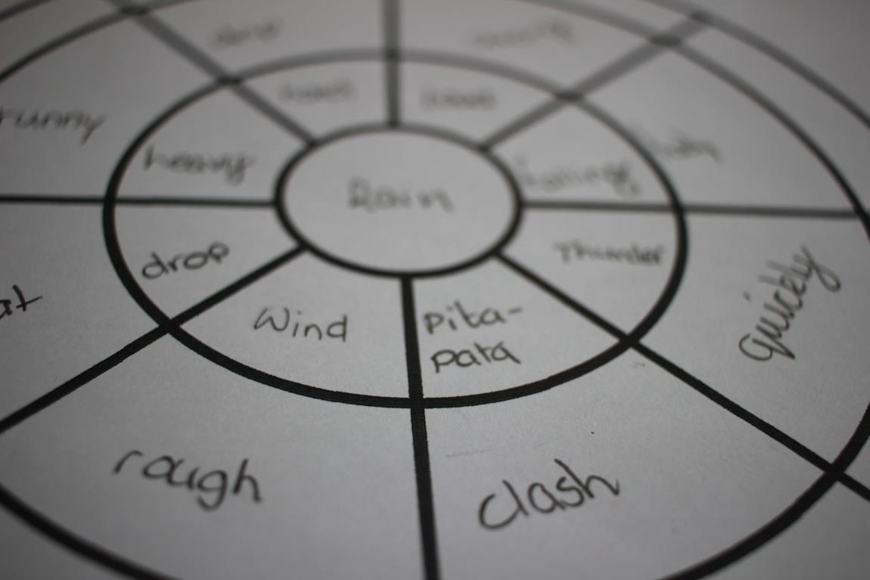
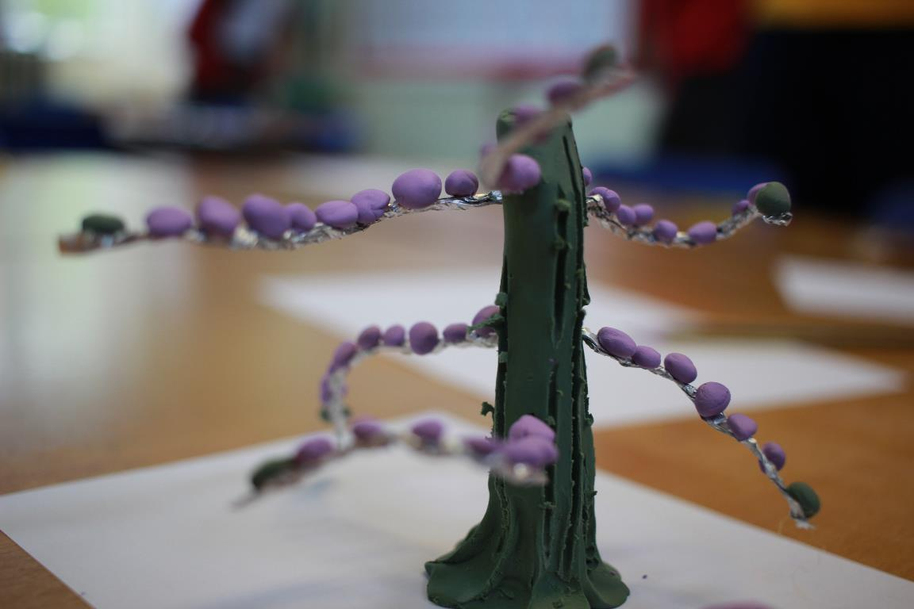
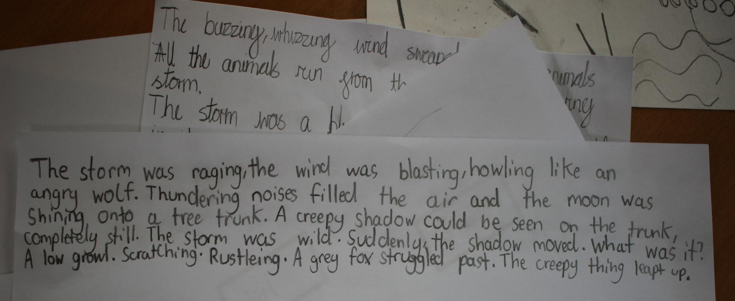


Writing for Change, Speaking for Change
Language Acquisition in the Primary Classroom
Dr Alicia Kent (alicia.kent@kcl.ac.uk)
Project Lead, Play @ languages @ King’s, King’s College London
1.
“My Mum saw on Facebook a message about the importance of making mistakes for better learning”
year 5 pupil
‘Learning is personal change’ is a touchstone of teaching practice in Higher Education. In two workshops with year 5 primary school pupils, I observed children’s attempts to incorporate their learning into their pre-existing knowledge structures by commenting on how an activity supported information from home or school, or challenged it. This complex process of readjustment or personal change was too challenging for some pupils and resulted in disruption. However, disruption was also a key feature of the pedagogy of our facilitator,
Phil Davis from Write Inspired.
2.
Learning through disruption
Part of this disruption came from the introduction of family languages usually external to the English-speaking primary classroom. The children’s use of their family language demonstrated a transactional level of oral language competence which struggled to meet the challenge of writing creatively in the family language, even in simple onomatopoeic work. However, as a marker of culture, the introduction of the family language into the classroom, accompanied by natural sounds (storms) and percussive rhythms used as pedagogical prompts, encouraged embodied practices like dance and movement. These are usually configured as disruptive classroom practices, but they led to more creative, collaborative, and performative schoolwork in the workshops. This resulted in positive outcomes for all children, including those who were initially challenged.
Observe
Disruptive activities included
music
percussion movement sounds
group writing speaking
poems
clay modelling storyboarding synonyms
performance changes of pace changes of place
For my analysis I am using the methodology
of pioneering child psychoanalyst Anna Freud,
which is based on a circular model of observation
used to better understand young children’s
development and behaviours
Propose
Discuss
Evaluate
4.
Learning through language
Language acquisition is creative and intervenes in personal and classroom development. Questions we want to ask next: How do pupils evaluate their own work with language? Does this differ from the ways they evaluate other schoolwork, and also each other’s work, and why? To what extent is language work a collaborative process, and what is the impact of this?
3.
Disruption for creative learning
Questions we asked after the observations were: how does introducing disruption affect pupil behaviour in the classroom? What does it mean to participate or not participate? What about pupil voice? Is it possible and/or important for the class teacher to be involved in the disruption?
For Phil Davis, students who read and who are read to progress better in writing tasks, and this is also the key message coming from schools. How do we fit home or second languages into this, especially when for the children these are transactional languages rather than creative languages? How could schools help here? What other options are there for children who don’t have this support to intervene in this practice? How might physical movement in the classroom help?
Work produced by the pupils in the workshops
King’s College London Ethics Approval Reference: LRS-17/18-6668

