Slide 1
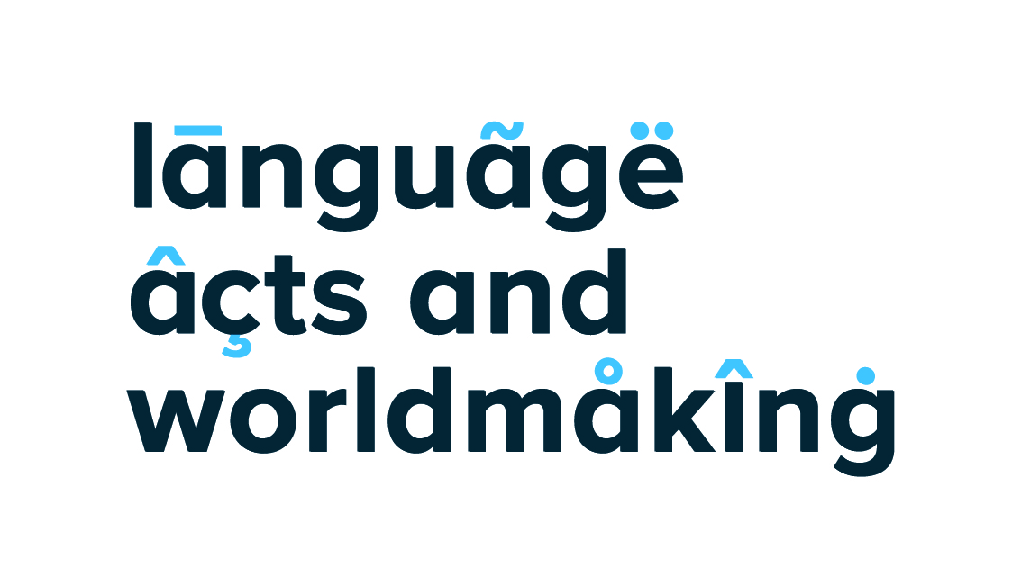
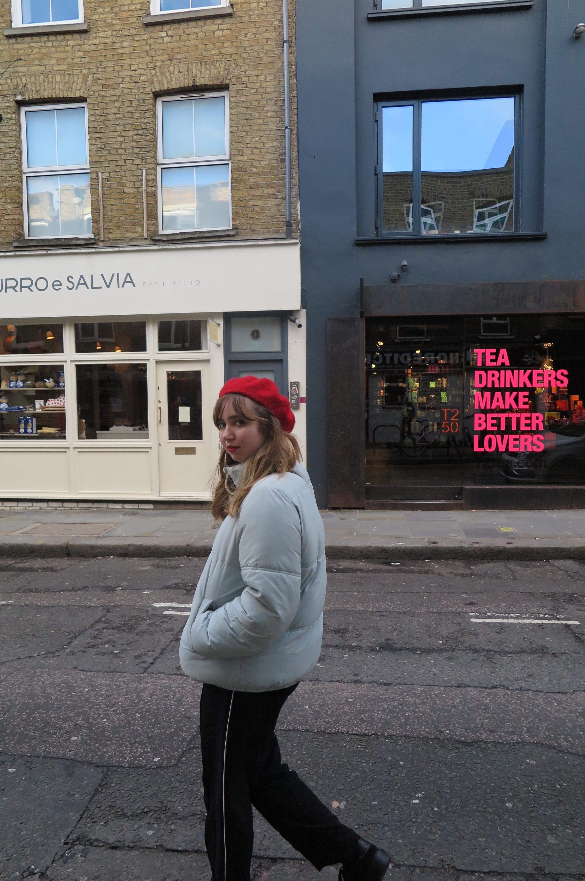
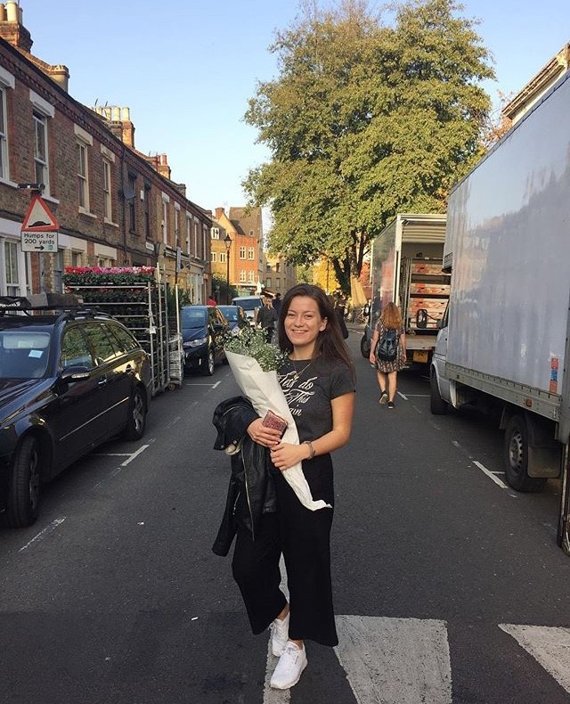
Stories in Sound – A Project Joining Worlds
Elisa Sampson Vera Tudela
Eleanor Catherall, KCL; Aude Langlois, KCL; Miguel Peña Novo, KCL
Senior Lecturer, SPLAS, KCL
Students acted as storytellers and radio producers interviewing native Spanish and Portuguese speakers, bringing to light unique life stories
The programmes had at their heart the vast multilingual and multicultural spaces of the Hispanic and Lusophone worlds but were told from a UK (and specifically, a London) angle.
Students built a multilingual portfolio of materials (audio, transcripts and translations) that will also be used in teaching. They benefitted from the opportunity to deal with authentic materials, were challenged in their ability to understand the spoken language and stimulated in their critical thinking and their agency for social change
Ellie Catherall:
Interviewing and Recording
Once my proposal had been accepted, I scheduled interviews with my two interviewees. Flavia I had met at Fresher’s Fair and Leo is a friend of my exchange partner. Both are students in London but go to different universities and study different subjects (Fashion and Neuroscience) which I thought would give my programme breadth and a basis for comparison. I wrote a list of around twenty questions about their lives and studies, with a few that were specific to what they study, where they live or what university they go to.
Recording the interviews was a slight challenge as the Dictaphone I planned on using was too quiet so had to improvise with a USB microphone. Editing the interviews afterwards really put my problem solving to the test as I had to teach myself how to use the software and cut down the hour’s worth of recording into a twenty minute programme.
Personal Reflections:
Upon completing my programme and submitting it, the next thing to do was to create a transcript and translation of this transcript into English. As my programme was entirely in Spanish this meant translating the entire dialogue. Whilst this was enjoyable, it was much more time consuming than I anticipated as it meant listening to the programme multiple times in order to note everything that was said during the interviews. As I was speaking to native speakers, this was the most challenging part as it meant often having to look up words I didn’t know. It was also very easy to miss some words, but luckily Elisa was able to fill in gaps where I couldn’t understand or made a mistake. Translating the transcript into English was comparatively easier as English is my native language.
Overall, from taking part in this project I feel like I have improved both in terms of practical skills (independence, resilience and organisation) as well as language skills (speaking, understanding and translating). Not only this, but I feel like I now have a greater understanding of the experiences and challenges of Spanish students in London and why they chose to study at a UK university. I believe this project will be incredibly beneficial in the future as I hope to go into broadcasting or journalism, as through making my programme completely self-sufficiently I am now able to produce interviews, record and edit and hopefully ask questions that are insightful and interesting.
Ellie Catherall
Ellie: “The project moves beyond simply documenting lives and develops cultural awareness, tests language skills and tests your ability to gather and present information in a way that is insightful and engaging. It also teaches the essential skills of being independent, resourceful and proactive when faced with challenges and decision-making opportunities.”
Ellie Catherall:
Spanish Students Studying in London
Aude Langlois: Indo-American Refuge and Migrant Organization
Miguel Peña Novo:
KCL Justice for Cleaners
Students Teaching Students
Ellie produced some fantastic
Supplementary materials:
Transcripts & Translations,
Websites details of student life
in London, on student views of
Brexit, blogs and articles.
Everything will be posted on the
Language Acts Website.
The materials will be used in
Language Teaching
in the Department of Spanish,
Portuguese and Latin American
Studies at KCL
We took advantage of in-house technology (KCL Radio and
Language Acts Website) to produce, distribute and exchange stories
Leo exploring Shoreditch
Flavia at Columbia Road Flower Market
Contact: elisa.sampsonvt@kcl.ac.uk

