Slide 1
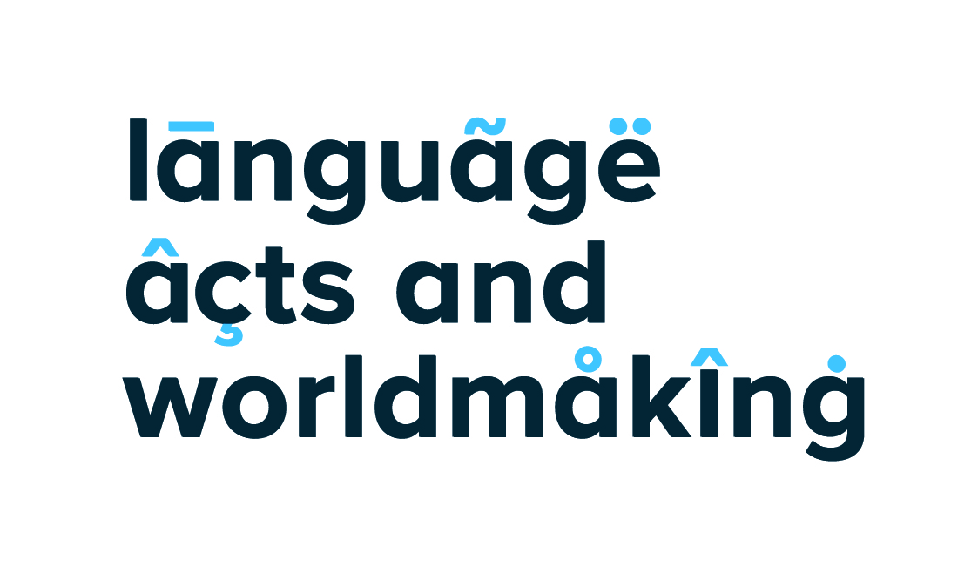
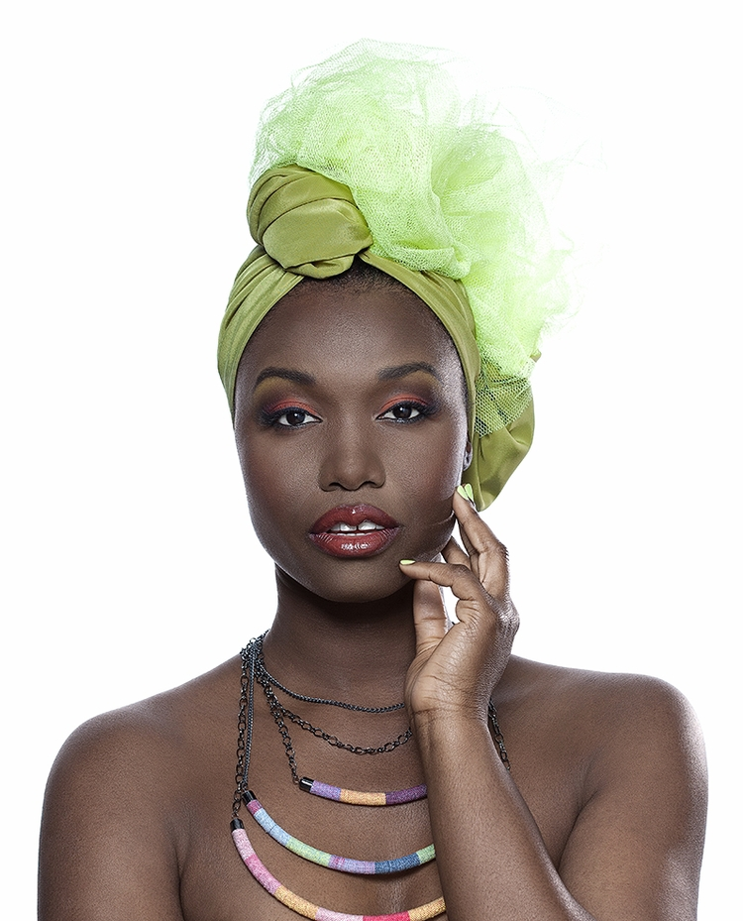
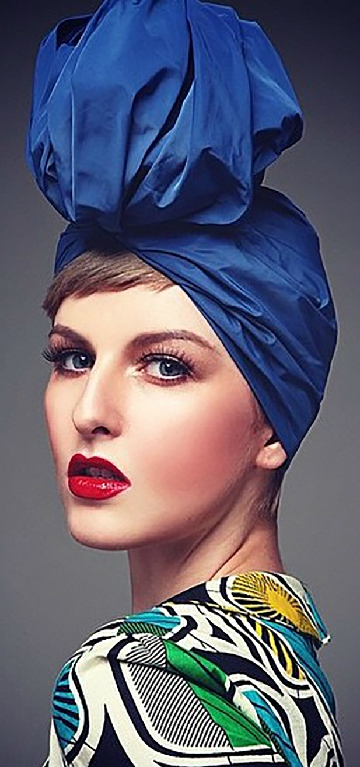
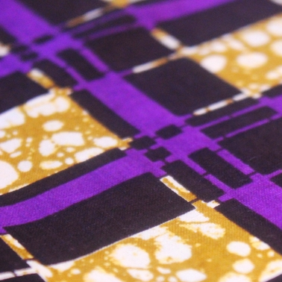
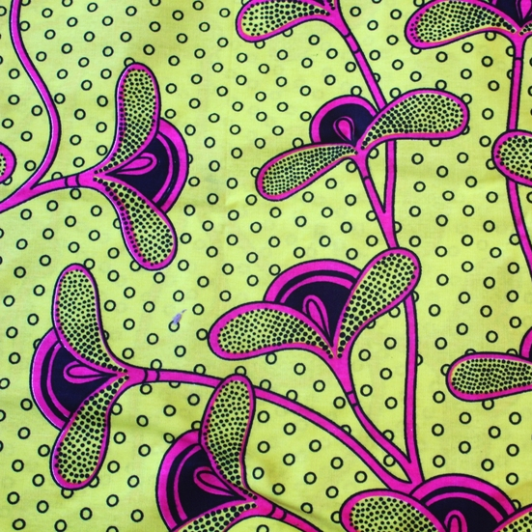
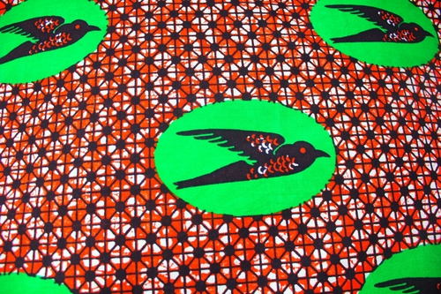
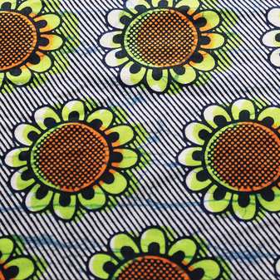
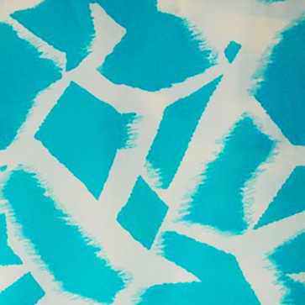
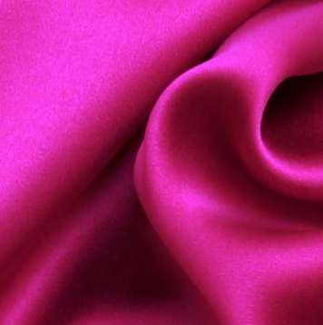
Fashioning identities and performing transnational ‘imaginaries’: fashion practices as diasporic spaces among the young Congolese community in London
Diasporic communities and language memory
Benedetta Morsiani
Department of Modern Languages and Cultures, University of Westminster. Email: w1580037@my.westminster.ac.uk
Framing the research
The research focuses on various forms of transnational fashion and beauty practices among members of the young Congolese community in London. Attention is given to the analysis of different kinds of fashion productions, such as garments, shows, magazines and websites, and, more broadly, forms of cultural and aesthetic rituals of the body as principal means for individual and collective cultural representations and forms of material culture among the young diaspora. The project involves both male and female informants, approximately between 18 to 35 years of age, who migrated from the DRC to Europe (through Belgium, France, or directly to London) with their parents/relatives at a young age or, in a few cases, were born and raised in London.
Main research aims
• To analyse how members of the young community re-think, re-construct and portray their cultural heritage through transnational fashion and beauty practices, unveiling the powerful storytelling inscribed upon the Congolese “fashioned bodies”.
• To evaluate how the multicultural context of London is shaping the production and embodiment of these cultural and beauty expressions.
• To investigate who the consumers of Congolese fashion practices are and investigate the general reception that these generate.
• To examine the ways in which young Congolese construct, embody, and manifest their racial, ethnic and gender identities through fashion and beauty expressions.
• To document the socio-cultural and economic contributions that young Congolese fashion and beauty practitioners make to the environment of London.
Theoretical framework and method
Performance and performativity theories on identity in everyday life and ritual experiences are applied as the central theoretical framework to investigate the ways in which racial, ethnic and gender identities are embodied and manifested within the young Congolese community in London. The performance/performative medium of fashion is redefined as the cultural construction of embodied identities and examined as the major Congolese narrative space of transnationality.
The research applies a qualitative-interpretivist perspective, with “multi-sited ethnography” (Marcus, 1995) as the main method to collect and analyse data. This follows: the people (especially migrants), the thing (commodities, gifts, money, works of art and intellectual property), the metaphor (signs, symbols, or images), the plot, the story or allegory (narratives of everyday experiences and memories), the life or biographies (of exemplary individuals) and the conflict (issues contested in public space).
A case study of the cultural and commercial production of Kiyana Wraps
Kiyana Wraps is a London-based Congolese fashion brand, run by three young Congolese women, which specialises in the production of women’s accessories, hand-stitched turban hats and ready-made headwrap models. The fashion brand merchandise also includes various kinds of headwrap fabric materials. Kiyana Wraps entire collection is characterised by a meaningful, multilingual, name selection.
A “Congolese story and journey”: Swahili
Each turban hat and headwrap model as well as most of the African wax-print fabrics are carefully defined by authentic Congolese Swahili names
Concluding remarks
The cultural and commercial production of Kiyana Wraps is transformed into a transnational geography and a multicultural lived social field (Dwyer, 2004). This embeds and evokes diasporic memories while interconnecting several places and cultures and transmitting a multifaceted experience of diaspora. The combined use of Swahili, French and English languages demonstrates how young Congolese women embrace “authentic” cultural and linguistic memories, preserve postcolonial linguistic legacies as well as being actively stimulated by the contemporary London environment.
Overall, the Kiyana Wraps fashion brand “re-formulates” the traditional African headwrap practice to:
• maintain a strong attachment with past experiences, evoking the creation of a sense of African-ness/Blackness; tracing and enhancing a “Congolese/African/Black story”, which is embedded into collective homeland memories, often affected by an idealised idea of the DRC and the African motherland (Tulloch, 2004, Strübel, 2012).
• embody gender configurations, where “feminist” and “feminine” identities are intertwined, representing a symbolic hybrid marker able to unite disparate women.
• exceed strictly defined racial and ethnic boundaries and transcend the binary of the “imagined” transnational attachments, creatively blending ethnic tastes with several cultural and stylistic inputs coming from consumers with heterogeneous cultural backgrounds.
Kikwit, Kwilu province, DRC Southwestern region
Virunga, Northern district of the capital Kinshasa and Virunga National Park in the North-Kivu province, DRC Eastern region
Maisha, ‘life’
Faraj, ‘consolation’
Postcolonial legacies: French
French-inspired names are also used to describe the headwrap fabric patterns.
Irondelle, ‘hirondelle’, swallow
Tournesol, sunflower
Dwyer, C. (2004) 'Tracing transnationalities through commodity culture: A case study of British-South Asian fashion', in Philip Crang, Claire Dwyer & Jackson, P. (eds.) Transnational Spaces. Oxford: Routledge.
Kiyana Wraps website: www.kiyanawraps.com.
Marcus, G. E. (1995) 'Ethnography in/of the world system: The emergence of multi-sited ethnography', Annual Review of Anthropology, 24: 95-117
Strübel, J. (2012) 'Get your Gele: Nigerian dress, diasporic identity, and translocalism', The Journal of Pan African Studies, 4 (9), pp. 24-42.
Tulloch, C. (2004) Black Style. London: V&A Publications.
London influences: English
Other fabrics of different materials such as cotton, silk, velvet, and satin have names inspired by London areas or national figures.
Mayfair, London borough of Westminster
Elizabeth Purple

